Slide 1
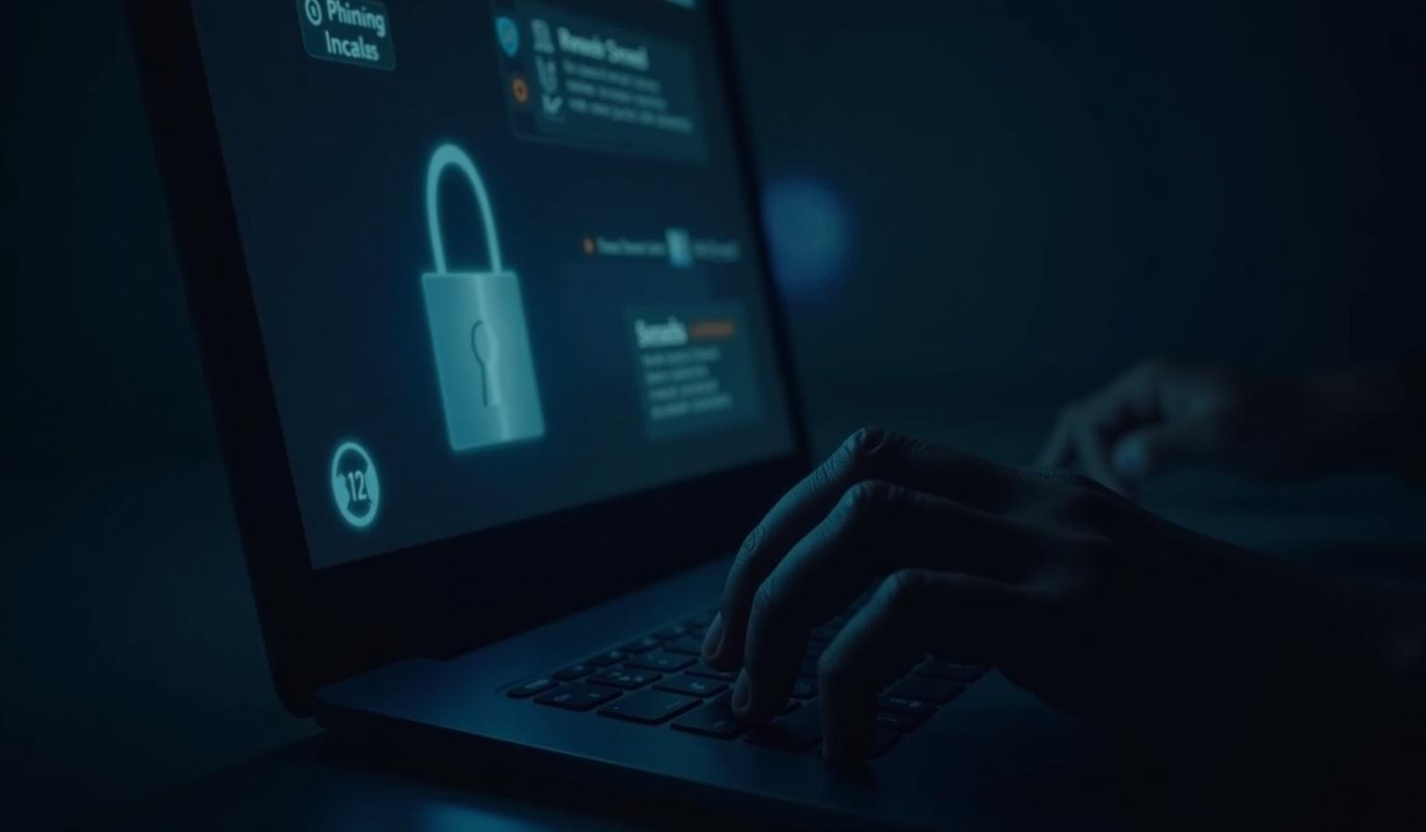
Phishing Awareness
Presented By=Vineet Gajbhiye

Slide 2

Introduction >>>>>

Slide 3
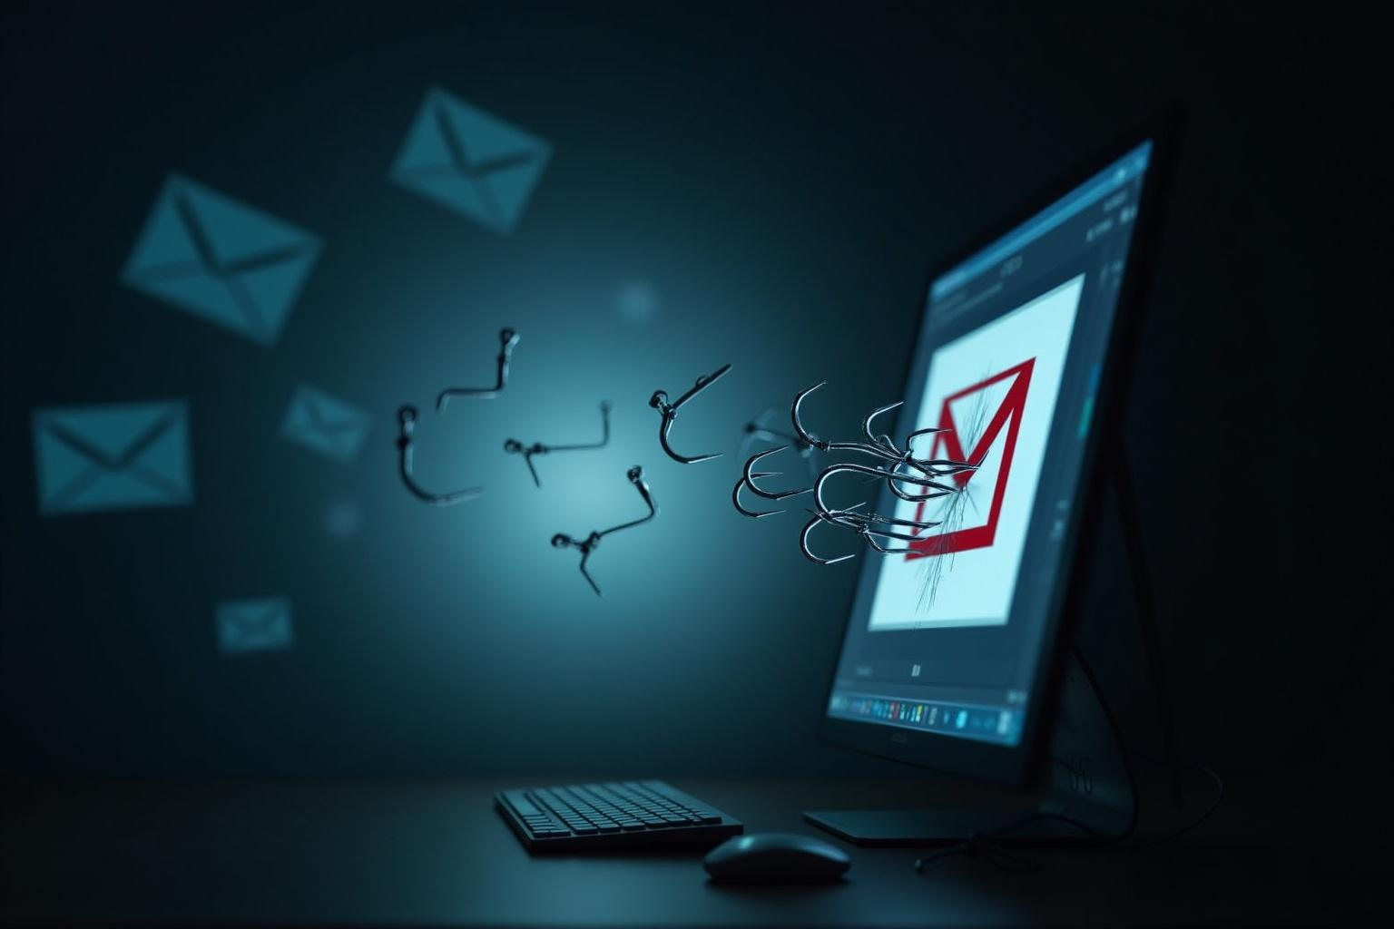
01
Phishing Overview

Slide 4
Definition of Phishing
Phishing is a sneaky type of cyberattack where scammers try to trick you into sharing your personal details. They create fake emails or messages that look like they’re from trusted sources, all to get things like your passwords or bank information. It's essential to be aware of this tactic to keep your info safe.

Slide 5
How Phishing Works
So, how does phishing work, you ask? It typically starts with a fake message that lands in your inbox. This message often has a link or an attachment urging you to click on it. Once you do, you might end up on a scam website or inadvertently download harmful software. Ultimately, the goal is to pluck your data right out of your hands, so being cautious is key!

Slide 6
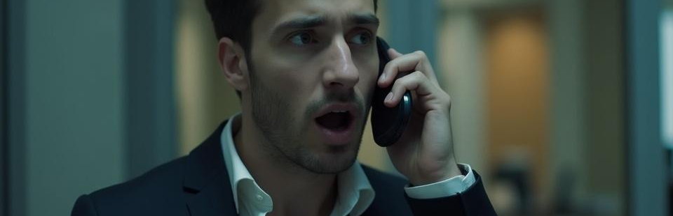
Common Social Engineering Tactics
Scammers often play tricks on your emotions to get what they want. They might pretend to be someone you know, like your boss or a bank rep, to create urgency—like saying your account is in trouble. This panic can make you act fast without thinking. They might also promise rewards or prizes to attract your attention and let your guard down.

Slide 7

02
Phishing Prevention
c

Slide 8
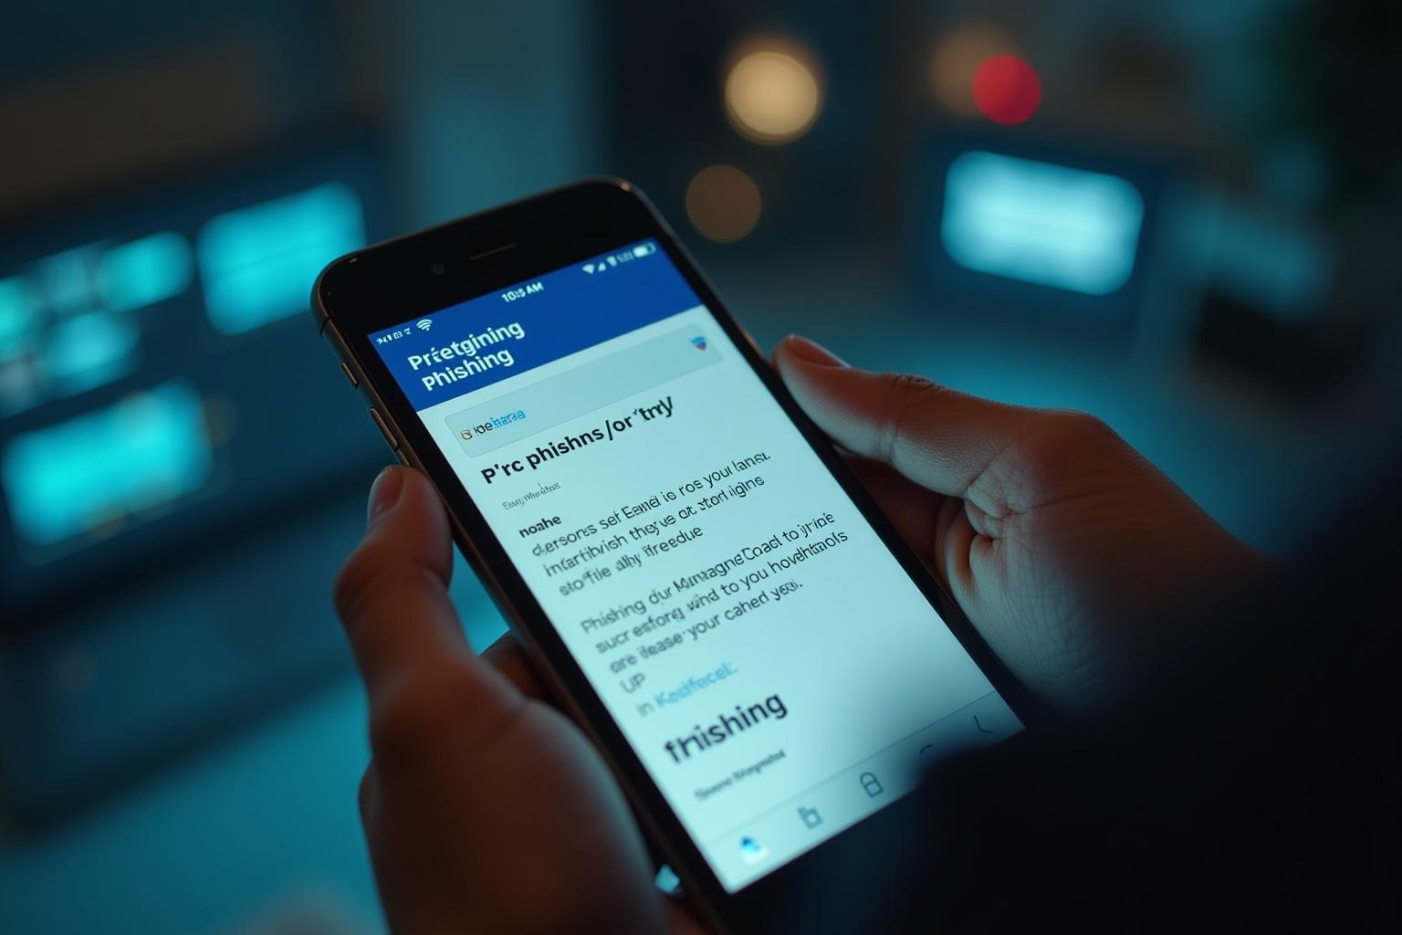
Recognizing Phishing Emails
Spotting a phishing email isn’t always easy, but there are telltale signs. Look for strange email addresses or generic greetings. If the message has typos or looks poorly designed, that's a red flag! Also, be extra cautious of messages pressing you to click on links or download attachments, especially if they seem urgent.

Slide 9
Identifying Fake Websites
Fake websites can be tricky to spot, but you can outsmart them! Make sure to check the URL closely for misspellings and ensure it starts with 'https://'—that little padlock icon means it’s secure. If the site looks poorly designed or asks for personal information unnecessarily, it’s best to steer clear.

Slide 10
Best Practices to Stay Safe
Staying safe online is all about being smart! Never click on suspicious links or download unknown attachments. Trust your gut—if something feels off, double-check! Use Multi-Factor Authentication for extra security, keep your software updated, and create strong, varied passwords for your accounts. And remember, sharing personal info over email or phone can be risky.

Slide 11
Conclusions
In a nutshell, being aware of phishing tactics and understanding how to spot them helps you stay safe online. By recognizing those red flags in emails and websites, and following solid safety practices, you can protect yourself from scammers looking to take advantage of you. Stay informed and stay secure!

Slide 12
Thank You

